Slide 1

How far the apple falls from the tree: Intergenerational transmission of educational attainment in Indonesia Dr. Syed Hassan Raza

Slide 2

Motivation
“Education represents the permanent characteristics of adulthood. Thus education is an important alternative to study the transmission over generations.” Indonesia serves an excellent case to study the transmission of education due to its ethnic and regional diversity.
To capture the educational persistence in Indonesia with and without putting the coresidence condition on the data.
How the persistence estimates evolve over time in Indonesia and how they differs across major ethnic groups and regions. Decompose the correlation following Checchi et al. (2008) to get the valuable insights.
To investigate the existence of long-run equilibrium over time, among regions and among ethnic groups.

Slide 3
Key Findings
We found 4% overestimation in correlation estimates for co-resident sample in comparison to entire sample.
We further analyze the pooled sample with 10 successive cohorts to capture the change in persistence over time. From 1941 to 1990, we do not find clear time trend in persistence estimates.
Through correlation decomposition, we uncover that the correlation at the lower end of fathers’ education distribution is offset by the increase at the top end of fathers’ education distribution.
From conditional probabilities we can see the policies which are able to transport those sons of less educated fathers to advanced level of education are not able to move those sons to advanced level where fathers have higher secondary education.

Slide 4
Key Findings
For ethnicities, we observe people belonging to Batak and Sundanese have less chances of obtaining the university education in comparison to the rest of the ethnicities.
In our region wise analysis, we found significant differences at regional level because in some of the regions we see higher persistence but in some of the regions trends in persistence estimates is not clear
when plotting stationary distribution we observe more masses in to university education for least asset holding regions like Yogyakarta and West Nusa Tenggara which suggest the education related policy is able to uplift the people towards university education in these regions.

Slide 5
Data Source and Sample Selection
We used all five waves of Indonesia Family Life Survey (IFLS) from 1993 to 2014. The IFLS is an ongoing longitudinal survey of Indonesia, which is representative of over 80% percent of the Indonesian population living in 13 provinces.
Our sample includes those who were between the ages of 25 and 53 during the five waves of IFLS, therefore, our sample was born between 1941 and 1990.
IFLS enables us to track the non-coresident household members. We observe 65% of the observations in the data were non-coresidents.
IFLS allows us to impute the years of schooling, use information on ethnic affiliation, and province of residence.

Slide 6

Empirical Setting
$S_{i,c}^{S}= α+ρS_{i,c}^{P}+ε_{i,c}$
$ρ= \int{\underset{A}{\underbrace{(S_{i}^{S}−E\left(S_{i}^{S}\right))(S_{i}^{P}−E\left(S_{i}^{P}\right))}}\underset{B}{\underbrace{P(S_{i}^{S}|S_{i}^{P})}}\underset{C}{\underbrace{P\left(S_{i}^{P}\right)}}}$
$\hat{ρ}= \sum_{S^{S}}{\sum_{S^{P}}{\underset{A}{\underbrace{(S_{i}^{S}−E\left(S_{i}^{S}\right))(S_{i}^{P}−E\left(S_{i}^{P}\right))}}}}\underset{B}{\underbrace{P(S_{i}^{S}|S_{i}^{P})}}\underset{C}{\underbrace{P(S_{i}^{P})}}= \sum_{S^{S}}{\sum_{S^{P}}{r_{S,P}}}$
$\sum_{j>t}{pr(S_{i}^{S}=j|S_{i}^{P}=t)}$
$\sum_{j<t}{pr(S_{i}^{S}=j|S_{i}^{P}=t)}$

Slide 7
Summary Statistics
Cohorts | Father’s Years of Schooling | Son’s Years of Schooling
1941-1945 | 5.48 | 7.17
1946-1950 | 6.06 | 7.70
1951-1955 | 6.39 | 8.03
1956-1960 | 6.52 | 8.10
1961-1965 | 6.76 | 8.72
1966-1970 | 6.96 | 9.44
1971-1975 | 7.26 | 9.71
1976-1980 | 7.52 | 10.34
1981-1985 | 7.55 | 10.58
1986-1990 | 7.57 | 10.70
Source: Author’s calculation from IFLS (Notes: We calculated cohort wise average years of schooling for both fathers’ and sons’ distribution by using all five wave of Indonesian Family Life Survey)
Descriptive statistics nation wide

Slide 8
Summary Statistics
Father-Son Sample
Regions | 1946-1960 | 1961-1975 | 1976-1990
West Java
Father’s Years of Schooling | 7.05 | 7.33 | 7.56
Son’s Years of Schooling | 8.14 | 9.27 | 10.15
Central Java
Father’s Years of Schooling | 6.19 | 6.60 | 7.08
Son’s Years of Schooling | 7.54 | 8.74 | 10.18
North Sumatra
Father’s Years of Schooling | 6.75 | 7.22 | 7.68
Son’s Years of Schooling | 8.51 | 9.73 | 10.94
Jakarta
Father’s Years of Schooling | 7.22 | 7.96 | 8.97
Son’s Years of Schooling | 9.51 | 10.63 | 11.88
South Sulawesi
Father’s Years of Schooling | 5.30 | 6.47 | 7.32
Son’s Years of Schooling | 6.59 | 8.63 | 10.10
Lampung
Father’s Years of Schooling | 5.92 | 6.18 | 7.17
Son’s Years of Schooling | 7.17 | 8.44 | 9.76
South Sumatra
Father’s Years of Schooling | 6.96 | 7.22 | 7.99
Son’s Years of Schooling | 8.27 | 9.37 | 10.43
West Sumatra
Father’s Years of Schooling | 7.11 | 7.43 | 8.54
Son’s Years of Schooling | 8.43 | 9.84 | 11.66
West Nusa Tenggara
Father’s Years of Schooling | 6.290 | 6.46 | 6.74
Son’s Years of Schooling | 6.95 | 8.71 | 10.43
Yogyakarta
Father’s Years of Schooling | 6.60 | 8.14 | 8.34
Son’s Years of Schooling | 9.47 | 10.97 | 12.26
Bali
Father’s Years of Schooling | 5.94 | 6.51 | 7.38
Son’s Years of Schooling | 7.11 | 9.51 | 10.88
Source: Author’s calculation from IFLS

Slide 9
Summary Statistics
Father-Son Sample
Variables | 1946-1960 | 1961-1975 | 1976-1990
Javanese
Father’s Years of schooling | 6.28 | 6.89 | 7.45
Son’s Years of schooling | 8.02 | 9.66 | 10.61
Sundanese
Father’s Years of schooling | 6.59 | 7.36 | 7.69
Son’s Years of schooling | 8.03 | 9.92 | 10.21
Other Southern Sumatrans
Father’s Years of schooling | 6.45 | 7.92 | 7.84
Son’s Years of schooling | 8.19 | 10.15 | 10.13
Batak
Father’s Years of schooling | 7.59 | 7.83 | 8.50
Son’s Years of schooling | 8.71 | 11.05 | 11.67
Betawi
Father’s Years of schooling | 5.03 | 6.97 | 7.39
Son’s Years of schooling | 7.87 | 10.10 | 10.88
Minang
Father’s Years of schooling | 7.04 | 7.68 | 8.67
Son’s Years of schooling | 8.76 | 10.43 | 11.98
Other Ethinicities
Father’s Years of schooling | 6.24 | 6.49 | 7.27
Son’s Years of schooling | 7.65 | 9.45 | 10.42
Source: Author’s calculation from IFLS (Notes: We used broader cohorts here and calculated average years of schooling for both fathers’ and sons’ education distribution by ethnicity).
Descriptive statistics on ethnic groups in Indonesia

Slide 10
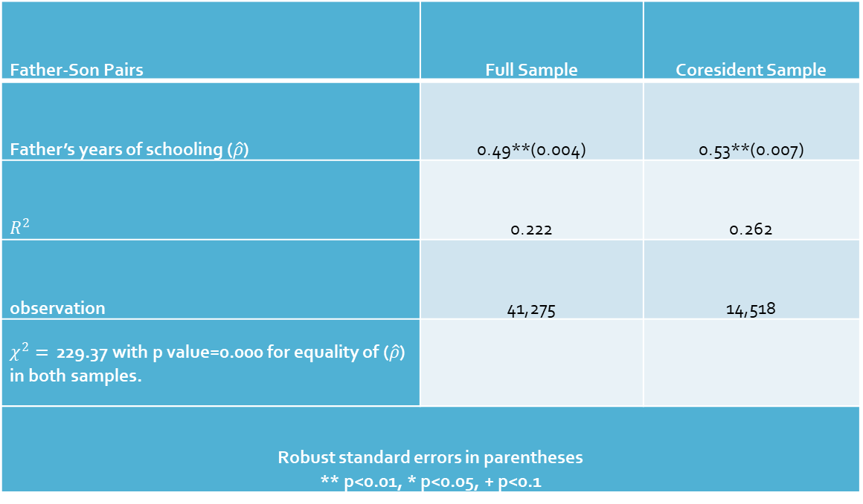
Intergenerational persistence in education attainment full sample versus coresidence sample
Father-Son Pairs | Full Sample | Coresident Sample
Father’s years of schooling ($\hat{ρ}$) | 0.49**(0.004) | 0.53**(0.007)
$$R^{2}$$ | 0.222 | 0.262
observation | 41,275 | 14,518
$χ^{2}=$ 229.37 with p value=0.000 for equality of ($\hat{ρ}$) in both samples.
Robust standard errors in parentheses ** p<0.01, * p<0.05, + p<0.1

Slide 11
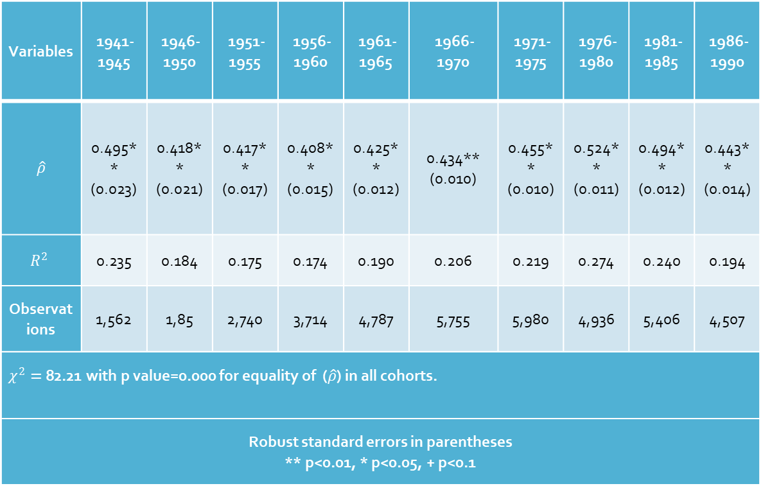
Cohort wise mobility estimates
Variables | 1941-1945 | 1946-1950 | 1951-1955 | 1956-1960 | 1961-1965 | 1966-1970 | 1971-1975 | 1976-1980 | 1981-1985 | 1986-1990
$$\hat{ρ}$$ | 0.495** (0.023) | 0.418** (0.021) | 0.417** (0.017) | 0.408** (0.015) | 0.425** (0.012) | 0.434** (0.010) | 0.455** (0.010) | 0.524** (0.011) | 0.494** (0.012) | 0.443** (0.014)
$$R^{2}$$ | 0.235 | 0.184 | 0.175 | 0.174 | 0.190 | 0.206 | 0.219 | 0.274 | 0.240 | 0.194
Observations | 1,562 | 1,85 | 2,740 | 3,714 | 4,787 | 5,755 | 5,980 | 4,936 | 5,406 | 4,507
$χ^{2}=$82.21 with p value=0.000 for equality of ($\hat{ρ}$) in all cohorts.
Robust standard errors in parentheses ** p<0.01, * p<0.05, + p<0.1

Slide 12
Transmission Rate (Father to Son)

Slide 13
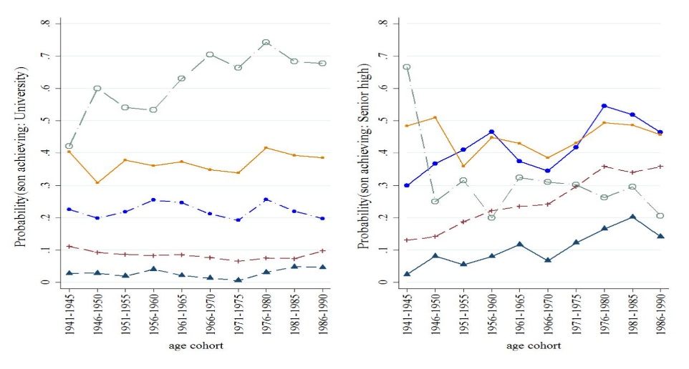
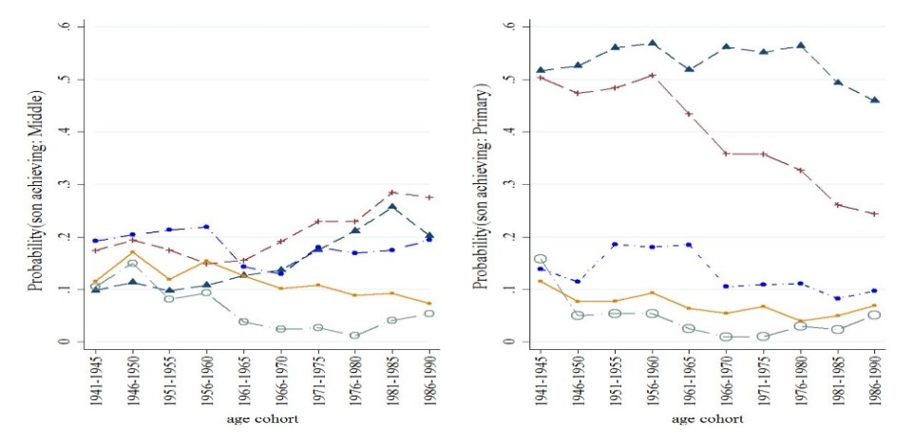
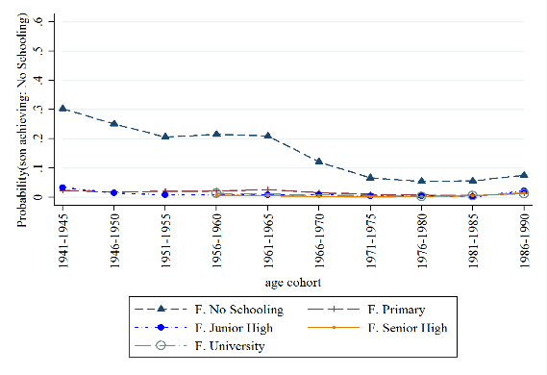
Probability of son attaining various level of education conditional on father’s education

Slide 14
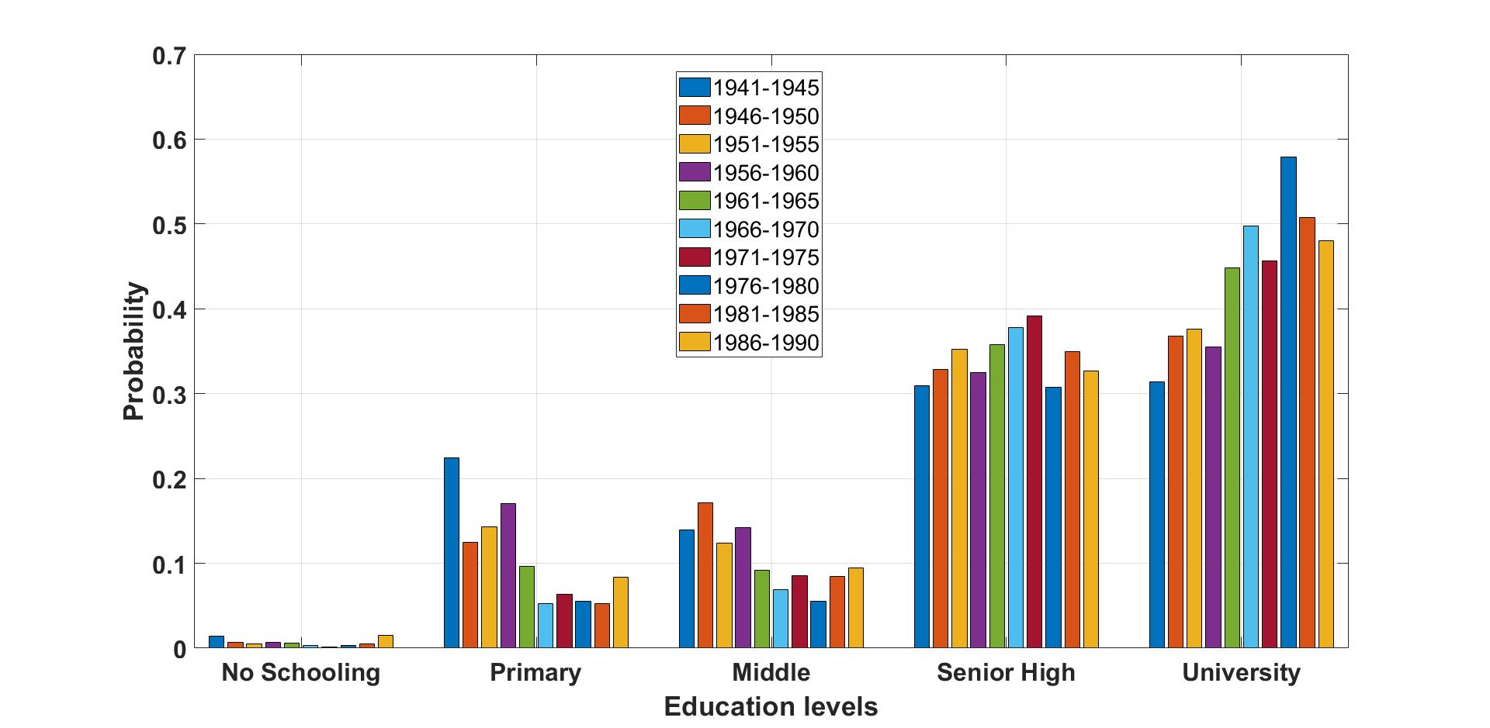
Stationary Distribution Plot over Cohort

Slide 15
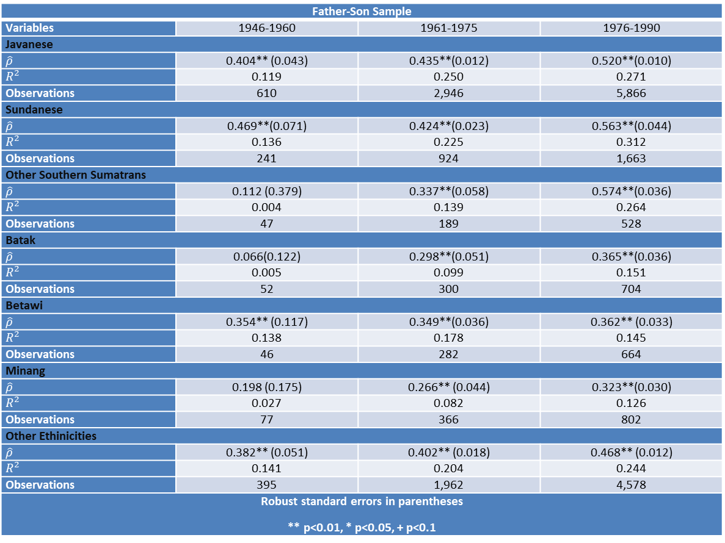
Mobility estimates on ethnic groups

Slide 16
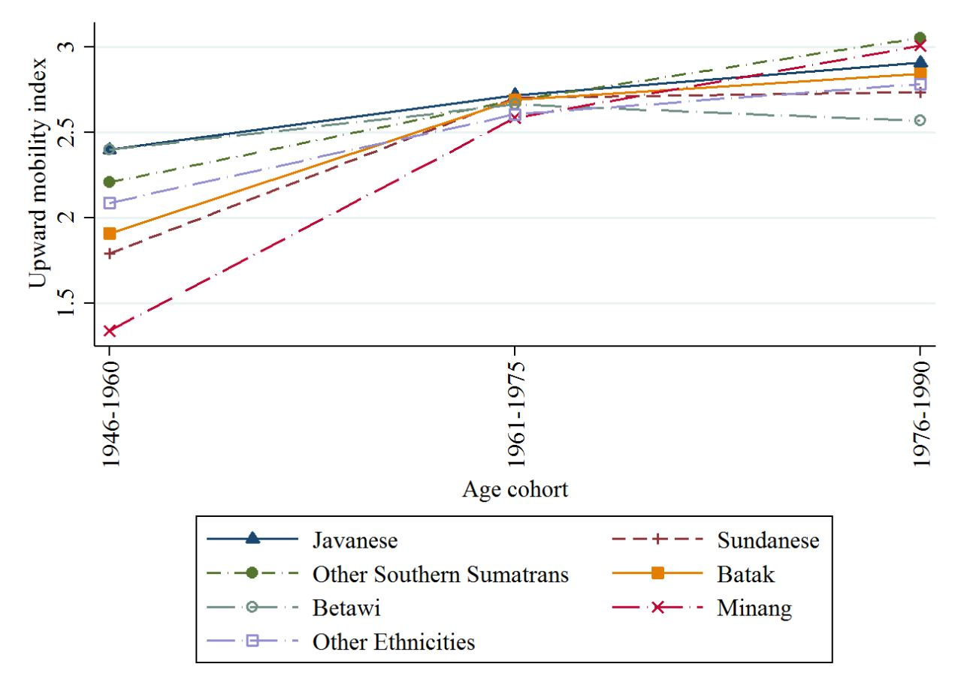
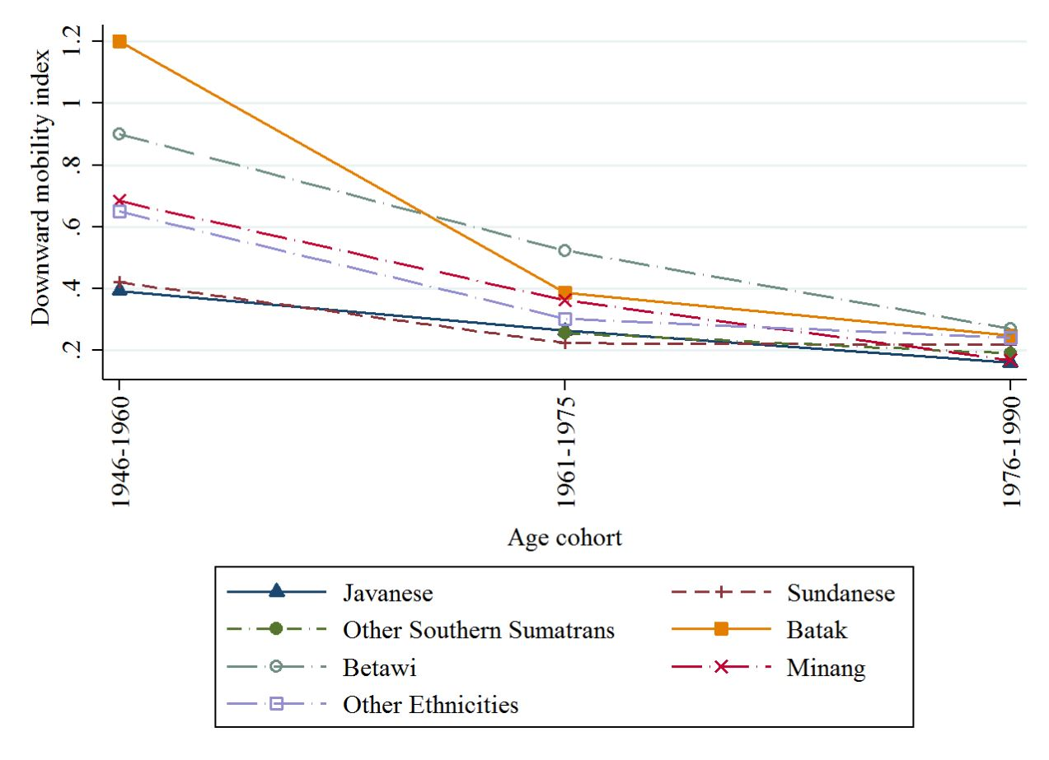
Upward Mobility Index over Ethnicities
Downward Mobility Index over Ethnicities

Slide 17
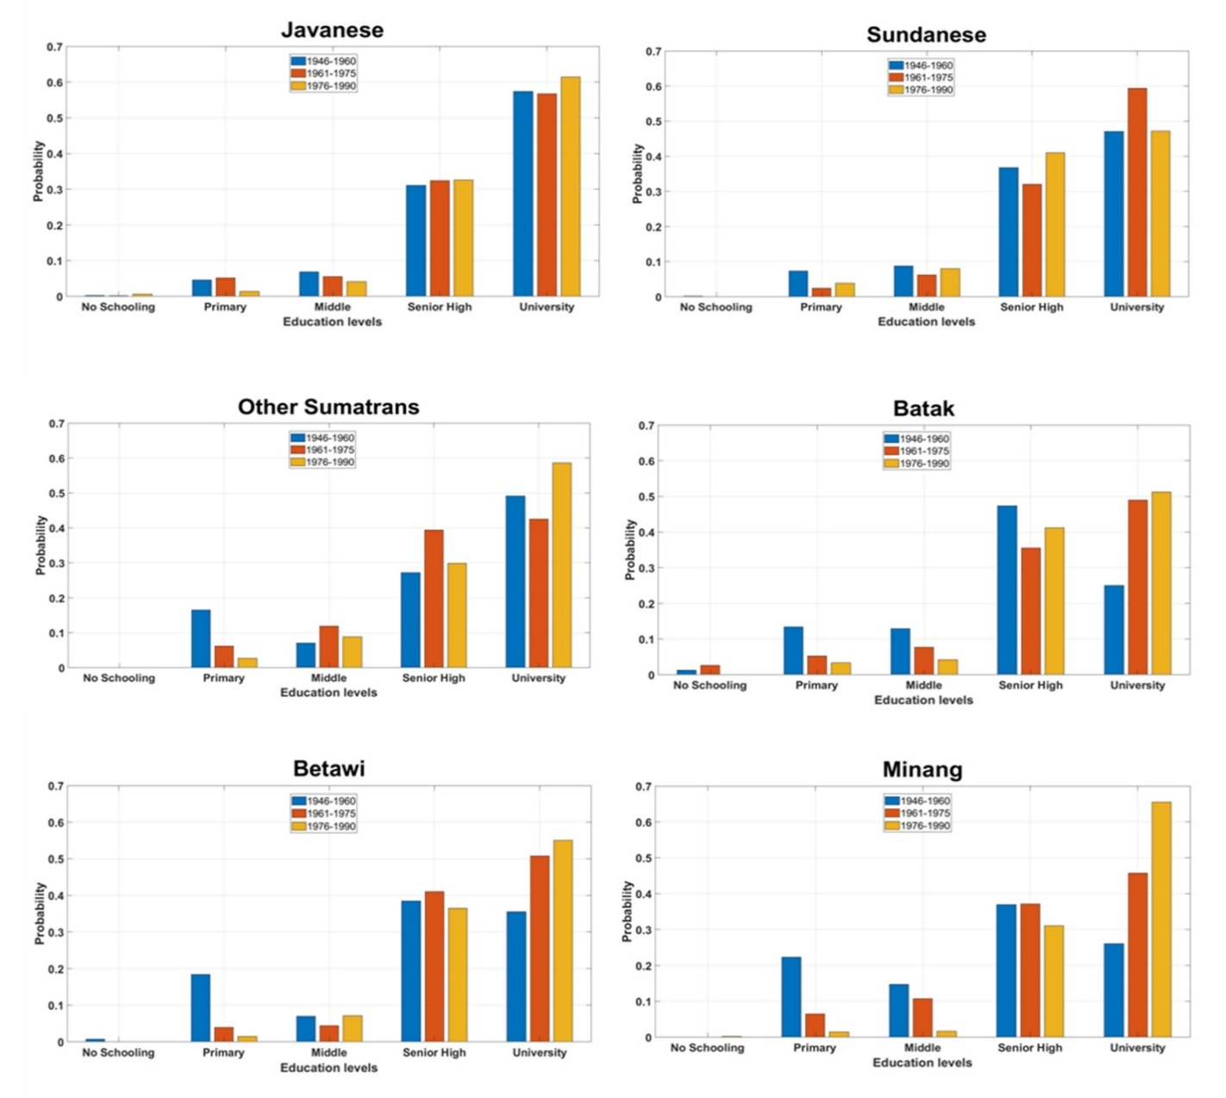
Stationary Distribution Plot over Ethnicities

Slide 18
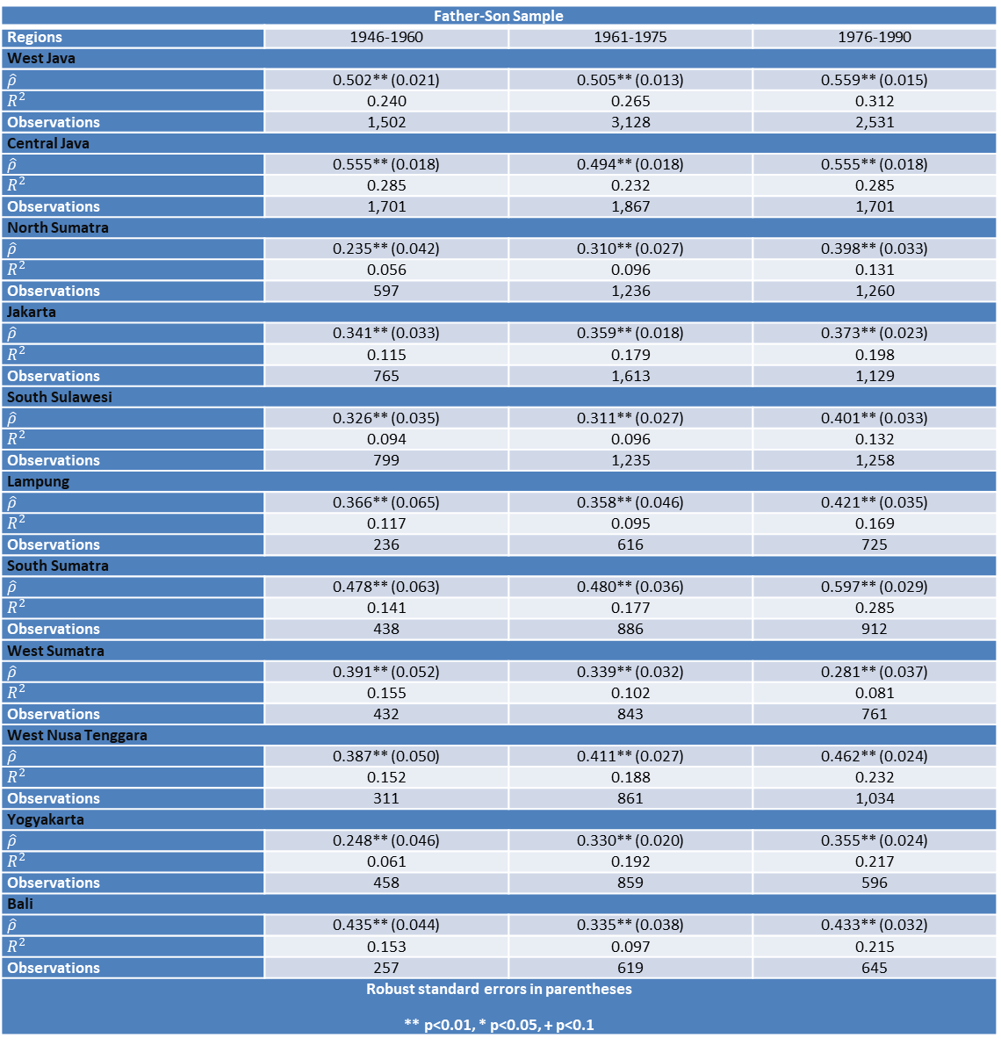
Mobility estimates over Regions

Slide 19
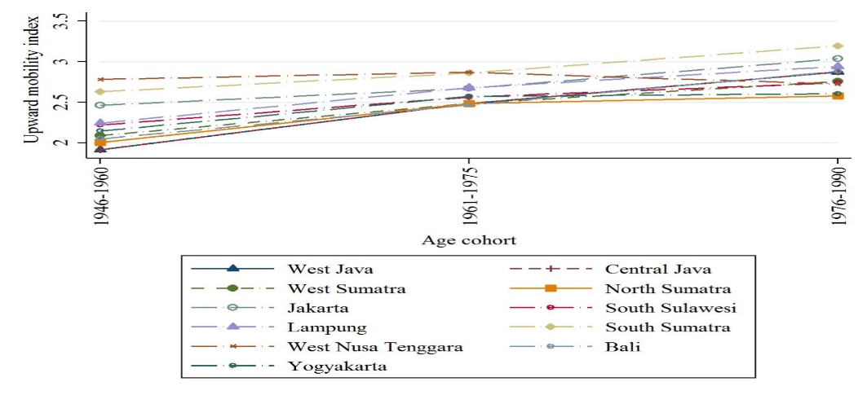
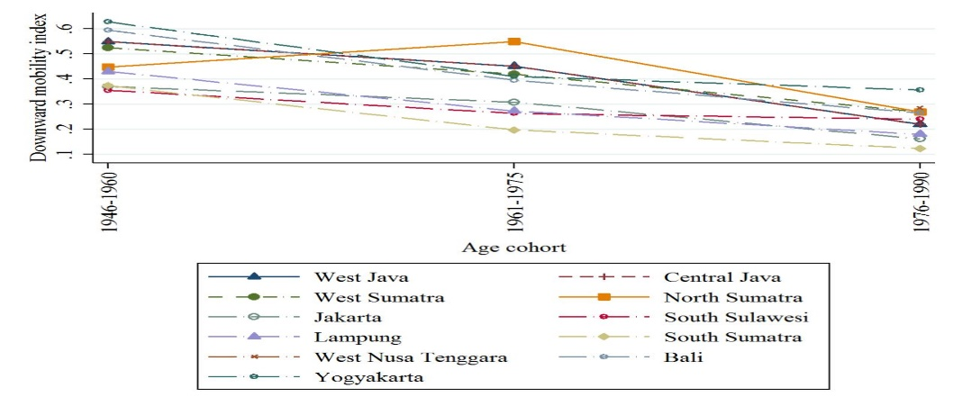
Upward Mobility Index over Regions
Downward Mobility Index over Regions

Slide 20
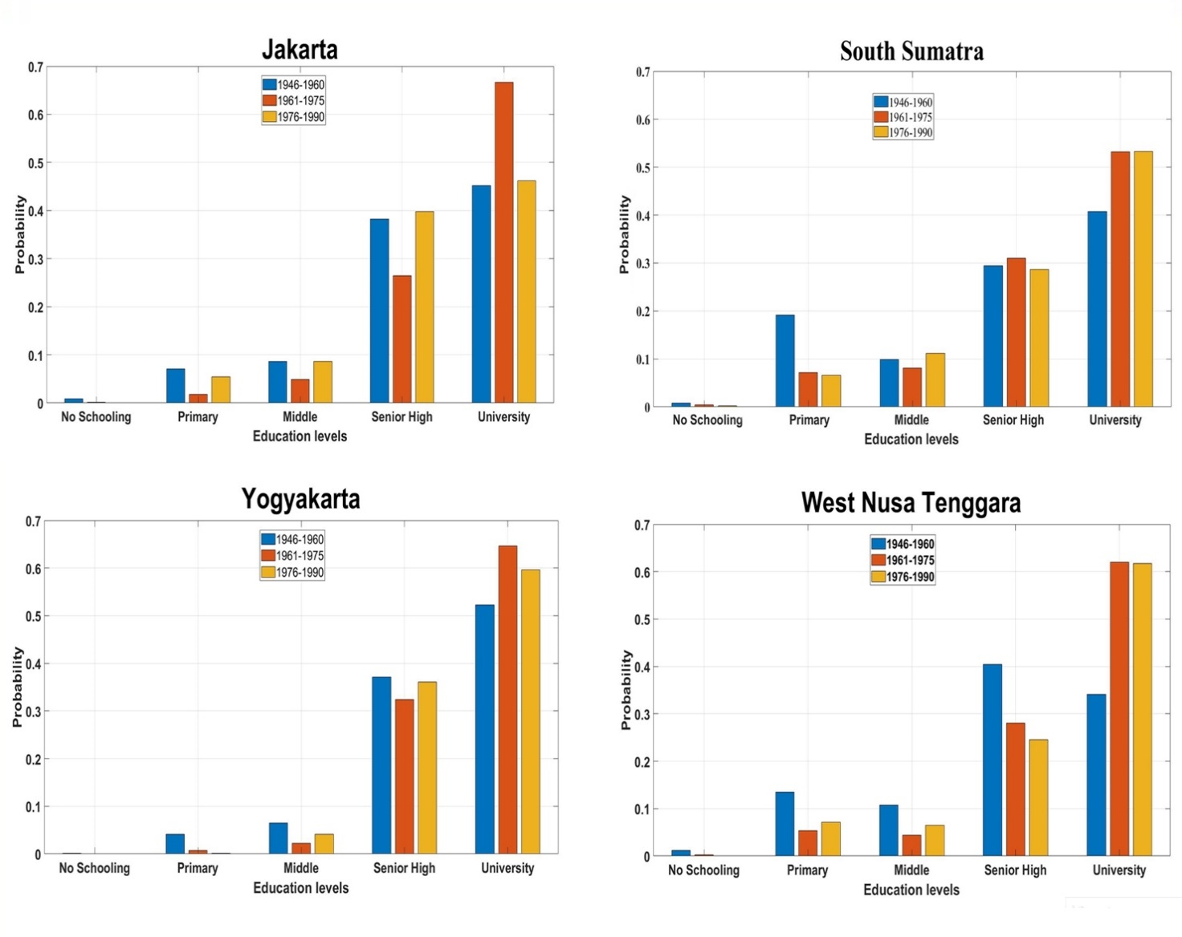
Stationary Distribution Plot over Regions

Slide 21
Results and Discussion
Over time we do not observe any secular trend in persistence estimates.
Findings from correlation decomposition reveals the decline in persistence at the lower end of fathers’ education shows that public education is progressively able to compensate for the lack of education inputs in the family.
We document higher stationary distribution for university education in Minang in comparison to other ethnicities for the most recent cohort.
We observed overall decline in downward mobility for all the regions.
Results from stationary distribution reveals non-convergence over regions and ethnicities.

Slide 22
Comments and Response
Table 1-3. The estimated correlation coefficients show no pattern. If you compare the 1941-45 cohort with the 1981-85 cohort, the two correlation coefficients are just the same (0.495 versus 0.494). If you compare the 1941-45 cohort with the 1976-80 cohort, you will see an increase in the correlation (0.495 versus 0.524). It is not clear why you can conclude “… but on the whole we document persistence estimates decline from 0.49 to 0.44 which means 5% decline in 50 years.” (p.9, section 1.4.2).
For this statement I was comparing the first (0.495) and last cohort (0.443). As I have mentioned at many instances that the trend over time is not clear, thus I stand corrected for this statement.

Slide 23
Comments and Response
Why is the focus on the “son” (as opposed to the “daughter”) when assessing intergenerational persistence in educational attainment? Women’s education is equally if not more important, especially for a developing country such as Indonesia. Hence, it could be argued that father-daughter combinations are at least equally worthy of investigation. Second, since mothers traditionally spend more time on child-rearing, especially in developing countries, the mother’s education level is more likely to have a significant impact on the next generation’s educational outcomes. Hence it is very important to also consider mother-daughter and mother-son combinations to see how intergenerational persistence plays out.
Fair comment that mother spend more time on child rearing. We performed the same analysis on mother-son pairs but in the interest of brevity only present father-son pairs. For father-son pairs we have more observations and we believe having more observations increases the predictive performance of our empirical strategy. Secondly we observe the similar results in our mother-son sample. For the father-daughter pairs, I would certainly like to keep it for future research.

Slide 24
Thank You

